Slide 1
Working through a professional Process
Inspired by Emily Carr and E.J. Hughes

Slide 2
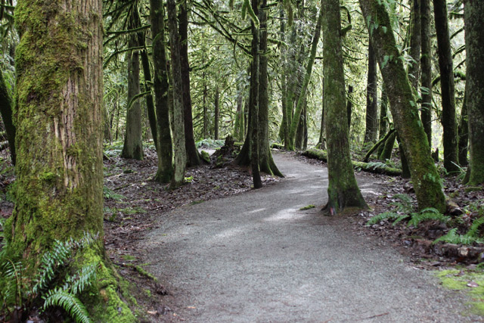
Step One: Observation
Find a place that means something to you and sit in it for a while. Listen to the sounds, smell the smells and look at what is there to see.
Consider this place from different angles than normal, maybe sit down low or get up high to change your perspective.
Once you find a spot you like, you will draw thumbnail sketches of a particular view that will inspire your final piece.

Slide 3
Step Two: Thumbnails
Thumbnail sketches are small and quick. They are NOT masterpieces .
They are merely something to remind you of this wonderful place you are observing.
I add written notes to mine too.

Slide 4
Step Three: Preliminary Work
Next I go back to my favourite thumbnail sketch and draw a larger image with form, tone, composition and lighting.

Slide 5
Step Four: Preliminary Work continued…
For my own project created some smaller pieces in water colour, then used them to inspire a larger piece in ink. My goal is still an acrylic piece, but sometimes it helps to go through extra steps to really consider various points of the composition.
For your project I just need you to do some tone studies in your sketchbook.

Slide 6
Step Five: Painting!
Once you’ve gone through that much with a composition, the final painting is simple! You know exactly what is going where, all you have to do is paint it.
This piece is 3’x2’ and only took me a couple of hours to finish… And I’m rusty!

