Slide 1
Studio art 2D
Artist research and inspiration

Slide 2
Artist name (or username, @, etc.)
Date alive: __________ to _________. Historical or Contemporary
Title of your favourite piece:
Date the piece was made:
Materials:
Fun fact:

Slide 3
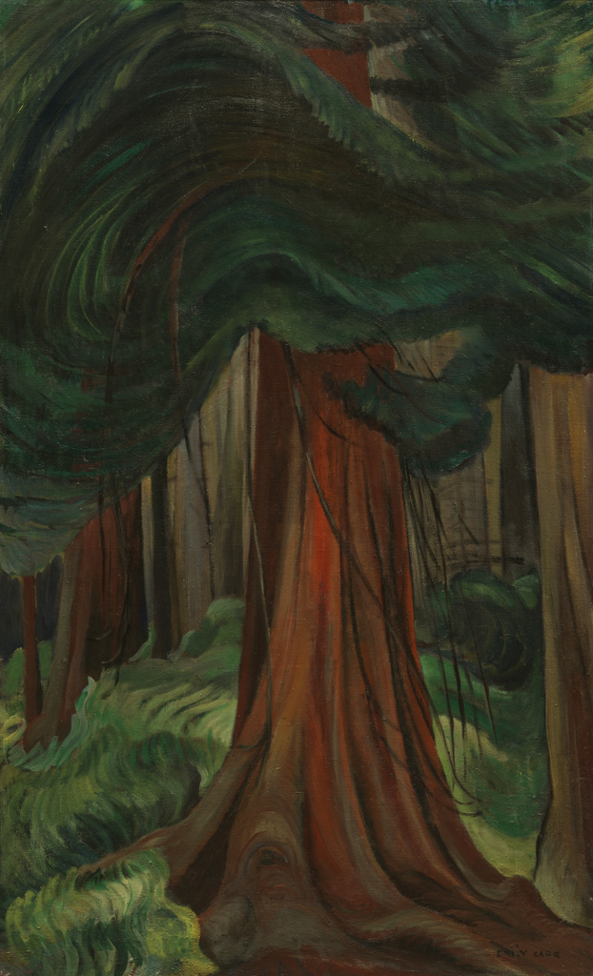
Emily Carr
Date alive: 1871-1945 (Historical)
Title of your favourite piece: Red Cedar
Date the piece was made: 1931
Materials: Oil paints
Fun fact: Emily Carr was one of the first Canadian artists to adopt a modern or post-impressionist style. She was inspired by the group of seven, (other Canadian landscape artists) and was often recognized as one, even though she never felt she was good enough to be.

