Slide 1
Masks of the world
Seriously, they’re really cool, and everywhere

Slide 2
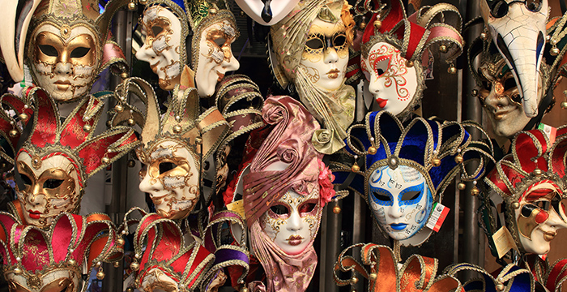
Venetian carnival masks
Where: Venice, Italy
Why: Worn for Carnival (11 day celebration In January or February)
When: Date back to 1400’s
Created to rebel against society of the times
Common features: long noses, elaborate decorations, feathers, bells.

Slide 3
Dia de los Muertos masks
Where: Mexico and Latin America
Why: celebration to honour the deceased and acknowledge death as a natural part of life.
When: November 1st and 2nd
Masks represent calavaras, or skulls.

Slide 4
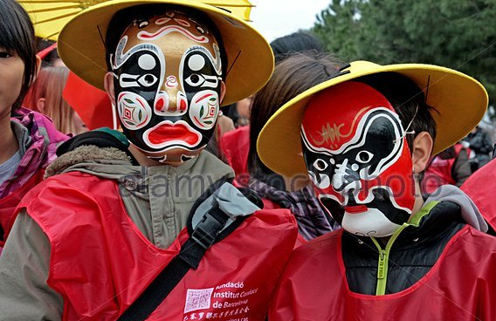
Chinese new year masks
Where: china
When: Chinese new year (week long celebrations in janurary or February depending on the calendar)
Why: designed to display the moods and emotions associated with the festival
Some masks represent deities, spirits and fabled animals that Chinese new year mythology originated from

Slide 5
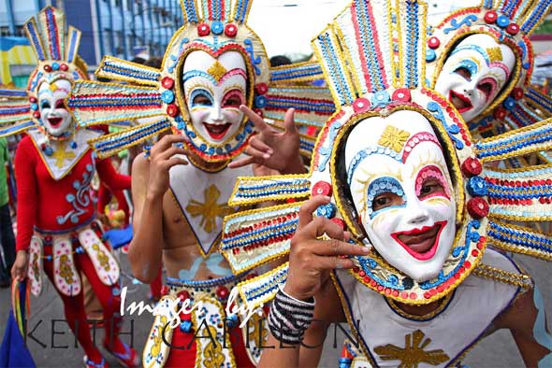
dinagyang masks
Where: Iloilo city, Philipines
When: the 3rd Sunday of January
Why: religious celebration to honor the santo nino (Child Jesus) and celebrate the arrival on panay (Most populated island of the philipines) of malay settlers
Masks sometimes include feathers, beads, sequins, but are always colourful.
Festival involves music and dancing in the streets

Slide 6
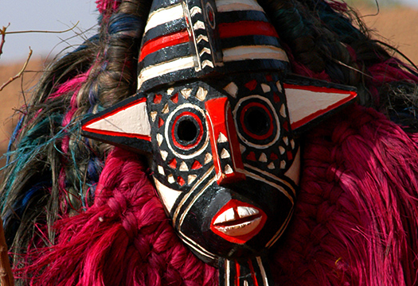
Festima Masks
Where: many west African countries such as: the ivory coast, Senegal, and burkina faso
Why: to celebrate the ancient custom of mask making itself!
What: festima is a celebration to protect the tradition of mask making, masks are made of wood, straw, leaves and textiles to represent animals and ancestral spirits.

Slide 7
Shinmokita tengu matsuri
Krampusnacht festival
Diablos Danzantes
Long, red-nosed goblins festival
Mythological tengu – bird nose and human featured creature in Japanese folk lore
Festival held in honour of mythical and mischevious creature from Jan 30-Feb 1
Mythical horned demon figure called Krampus punishes misbehaving children around st. Nicholas day
Festival coincides with st. Nicholas day, krampusnacht celebrators adorn masks to oppose st. nicholas
Dancing devils masks are worn during a festival in Venezuela celebrating the triumph of good over evil.
Masks resemble winged dragons. These masks often take all year to craft by hand.

Slide 8
Ceremonial Northwest First nations
Can display animals, humans, forces of nature, supernatural beings
Some stories recount when supernatural beings took on human forms near waterways or rivers, which then designated territorial boundaries and homelands.

