Slide 1
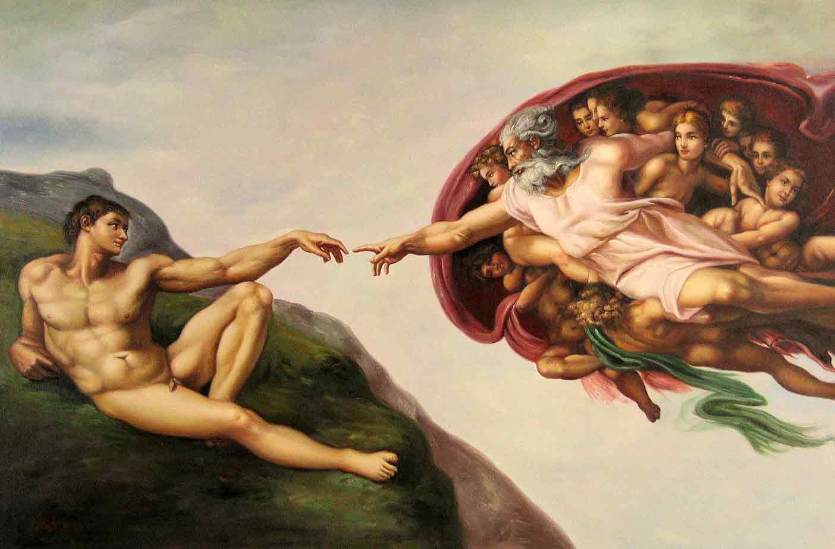
Elements of Design
THE BUILDING BLOCKS OF STRONG VISUAL ART

Slide 2
What are the elements of design?
The elements of design are certain “rules” that, when considered, help to create a strong visual image.
Incredibleart.org thinks of it like this:
“An element is one of those most basic visible things. In science, the elements are on the periodic chart (hydrogen, iron, oxygen, gold, sulfur, etc.). All the complex chemicals are simply combinations of these (H2O). In art, it is an element if it is visible and there is nothing more simple or basic to define it. It cannot be a combination of more than one thing and still be an element. In practice, the elements are commonly seen in combination with each other. For example, color and value are very different elements, but they always exist in combination with each other.”

Slide 3
Are elements the same thing as Principles?
No! But they are frequently talked about together.
If the elements of design are like elements on a periodic table, principles are like their attributes – like sodium will combust in a reaction with water. Colours will seem brighter when beside their compliment.

Slide 4
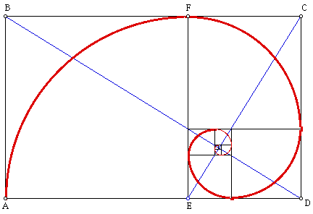
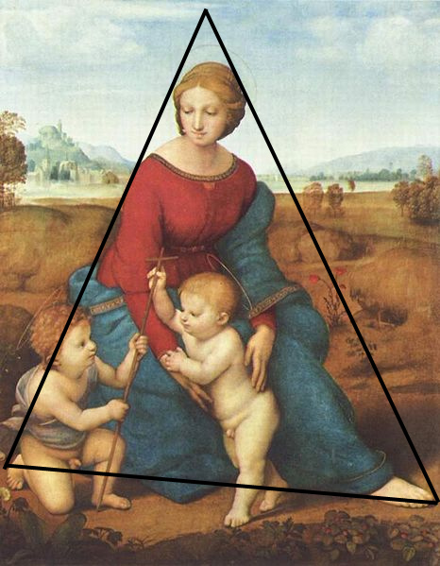
Composition
How you arrange the various components of your piece. (Usually based on principles like: we read right to left, big objects seem closer than small ones and warm colours advance while cool recede.)

Slide 5
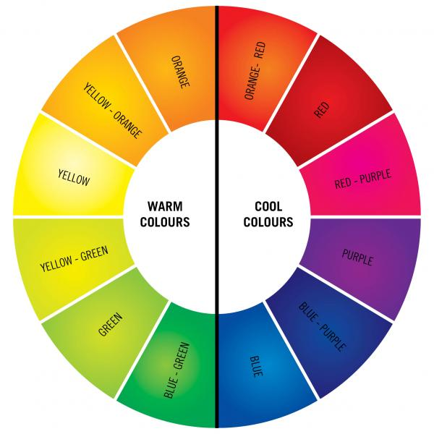
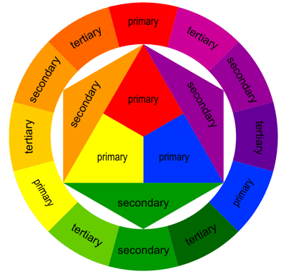
Colour
Colour is sorted into primary and secondary colours which can be seen on the colour wheel. Tint and hue can be made by adding black, white or a compliment.

Slide 6
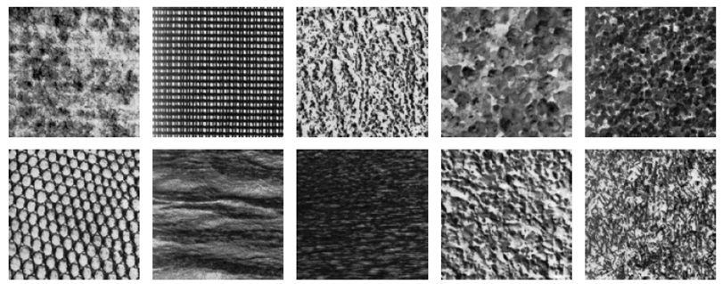
Texture
Texture is the “feel” of an object and can be either visually represented or physically represented by using alternate materials.

Slide 7
Value and Contrast
Value is the level of tone of an object, how close to black or white it is.
Contrast is the relationship between black and white in your image, high contrast has a lot of very black blacks and very white whites, low contrast has a lot of greys.

Slide 8
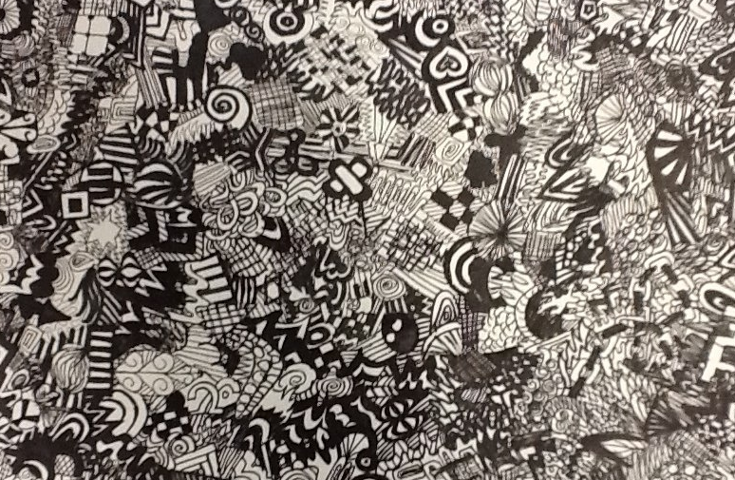
Line
A line is anything that defines a shape. It can be thick, thin, soft, hard, fuzzy, clear etc…

Slide 9
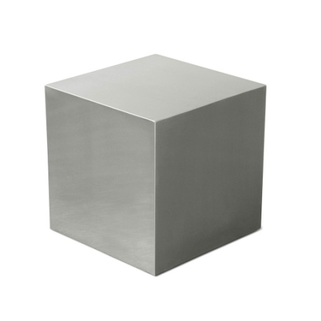
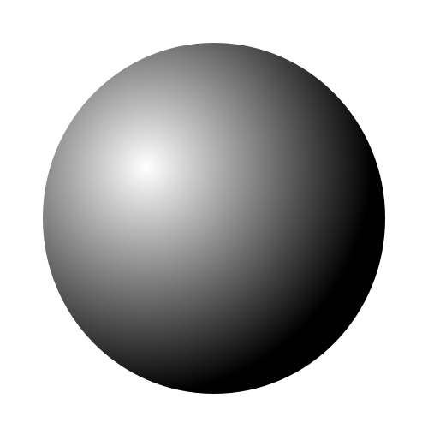
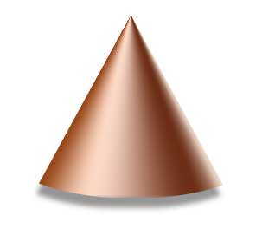
Shape and Form
A shape is a 2D object made by a line.
Form is a 3D object made by Tone and Shading.

Slide 10
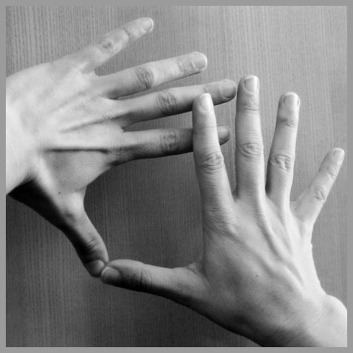
Space
Space refers to how your shapes/forms are placed in relation to each other. While composition refers to how you intentionally place the objects, space refers to the unintentional areas between objects once they are placed.

