Slide 1
Ancient ceramics
For grade 8’s

Slide 2
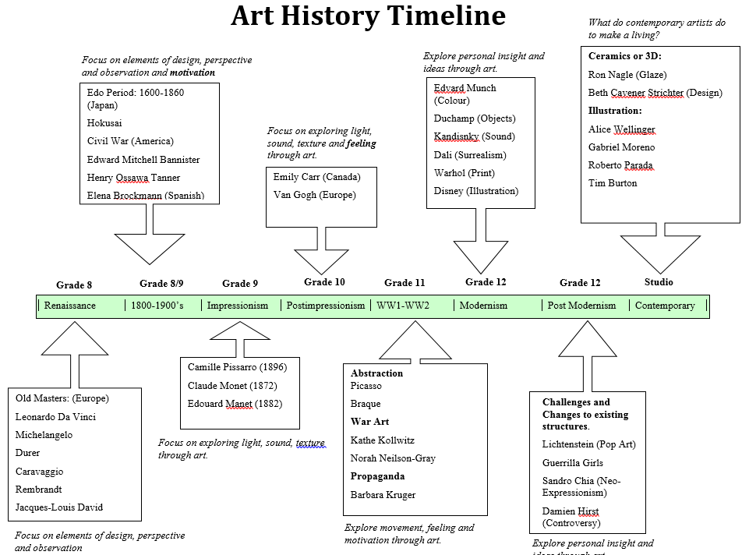
The Timeline
Ancient – Middle Ages
Egypt: 4000-3000 BCE
Greece: 1000-400 BCE
China: 1000 CE

Slide 3
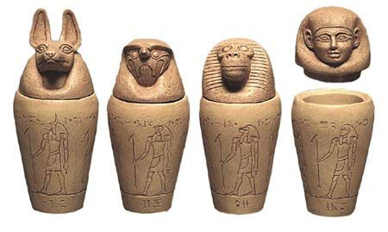
Ancient Egypt
Ancient Egyptians used clay for a variety of ceremonial or household items because, thanks to the Nile River, there were vast clay deposits as opposed to other materials like wood or metal.
Vases and Vessels would be used to store everything from food and drink to trinkets.
Artists created early versions of “labels” on the outside of these vessels so they could be differentiated. The pictures on the outside would often depict what was to be stored on the inside.

Slide 4
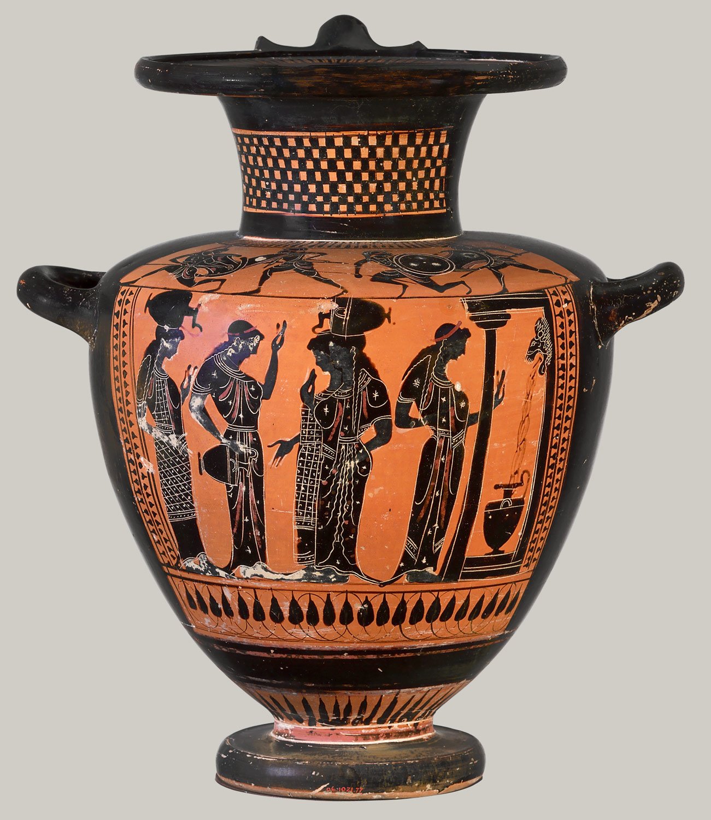
Ancient greece
Greece is well known for it’s pottery because of the superior clay and materials the land had to offer over other materials. (Like Egypt, but even more so!)
Around 600 BCE Athens became known as a center for pottery, making Athenian artists’ signature style of black figures on an orange background iconic.
Artists were either hired, or free to depict whatever tales they so chose, and took ownership of their designs – they even signed them!

Slide 5
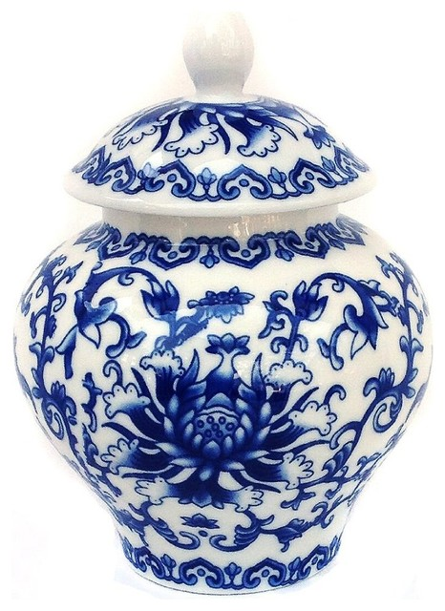
Middle Ages - China
The oldesnt known pottery in the world was found in China and dates back to 20, 000 years BCE!
The best known pottery depicting Chinese styles would be the classic blue and white porcelain developed in the Yuan Dynasty from 1279-1368 CE.
Each dynasty had it’s own styles – some depicted particular stories, or patterns or colours. The Yuan dynasty was influenced by Mongolian culture, specifically preference to the colour white.

Slide 6
Show me your learning
Egypt
Greece
Take out a piece of paper (it can be the back of the project outline) and draw a grid with 9 sections. (3 across and 3 down)
Across the top write EGYPT, GREECE, and CHINA
Down the columns write three points from the notes in your own words.
Finally, circle your favorite type of ancient pottery and write this sentence:
I LIKE __________ POTTERY BEST BECAUSE _______________________.
China
I LIKE __________ POTTERY BEST BECAUSE ________________________________________________.

